Slide 1
Direct Execution and Thread API
Kenzhetai Arman
Imanbayeva Diana
Kunanbai Darkhan
Kydyrbai Magzhan

Slide 2
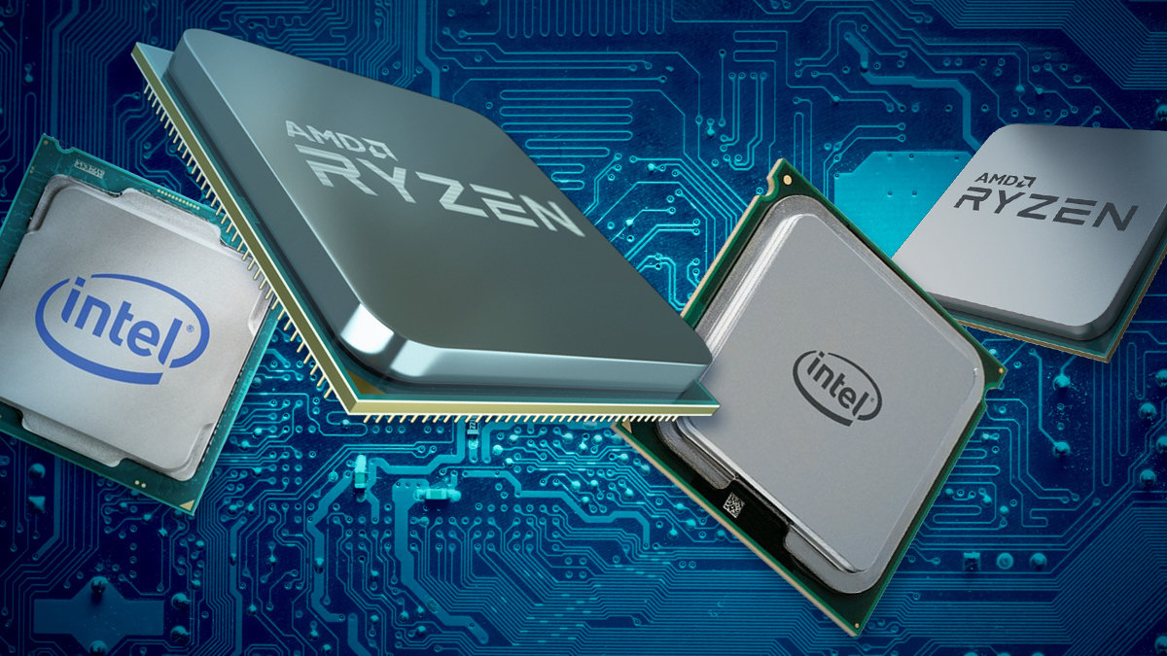

Introduction
In modern operating systems and multithreaded applications, two key mechanisms play a crucial role: Direct Execution and Thread API.
Direct Execution allows the CPU to execute program code directly, without additional layers of abstraction, ensuring high performance.
Thread API provides tools for creating and managing threads, which is especially important for multithreaded applications requiring parallel task execution. Understanding these concepts is essential for developing efficient and secure software systems.

Slide 3
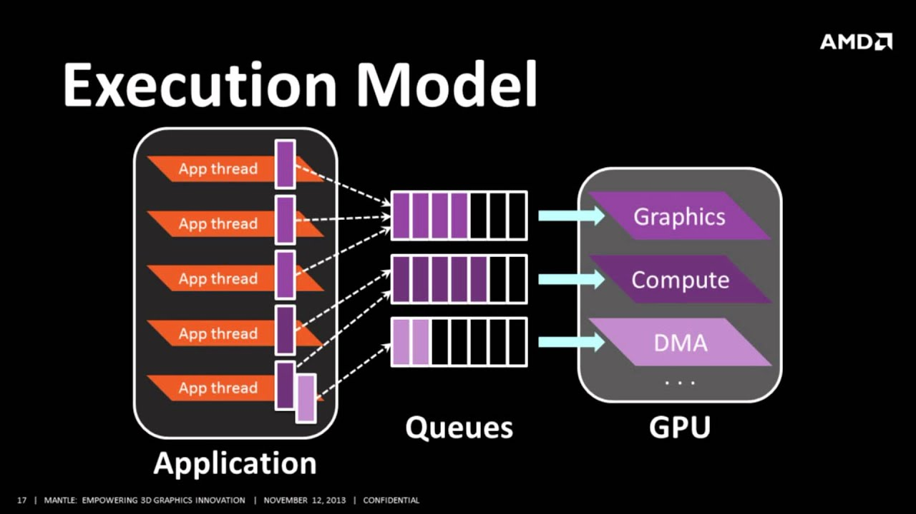
Direct Execution is a mechanism where the CPU executes program code directly, without intermediate abstraction layers. This means that program instructions are passed directly to the CPU for execution. Advantages of Direct Execution: 1) High performance, as there are no overheads from additional abstraction layers. 2) Minimal delays in code execution. Disadvantages of Direct Execution: 1) Lack of isolation between processes, which can lead to conflicts and errors. 2) Potential security issues, as the code executes with full access to system resources. Direct Execution is often used in systems where performance is critical, such as real-time systems.
Direct Execution

Slide 4
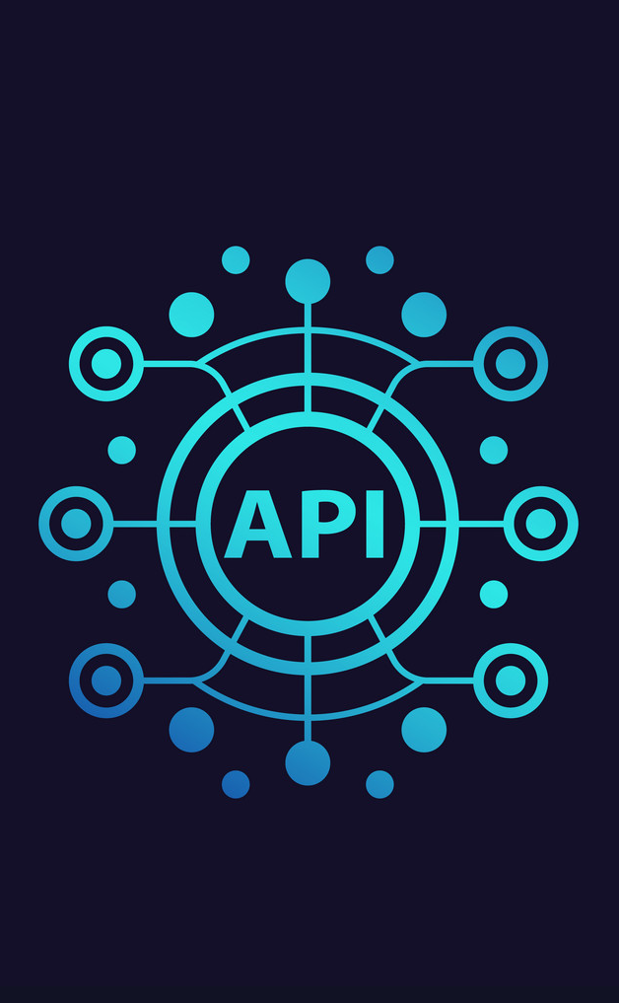
Thread API is a set of functions and tools provided by the operating system or libraries for working with threads. Threads allow programs to perform multiple tasks concurrently within a single process. Key Functions of Thread API: Thread creation: e.g., pthread_create in POSIX or CreateThread in Windows. Thread management: waiting for thread completion (pthread_join), terminating threads. Synchronization: using mutexes, semaphores, and other mechanisms to prevent conflicts. Examples of Thread API: POSIX Threads (pthreads) — a standard for Unix-like systems. Windows Thread API — a set of functions for working with threads in Windows. Thread API enables developers to create multithreaded applications that efficiently utilize CPU resources.
Thread API

Slide 5

Comparison of Direct Execution and Thread API
Direct Execution: Direct execution of code by the CPU. Suitable for tasks where maximum performance and minimal overhead are critical. Not suitable for multithreaded applications, as it lacks thread management mechanisms.

Slide 6
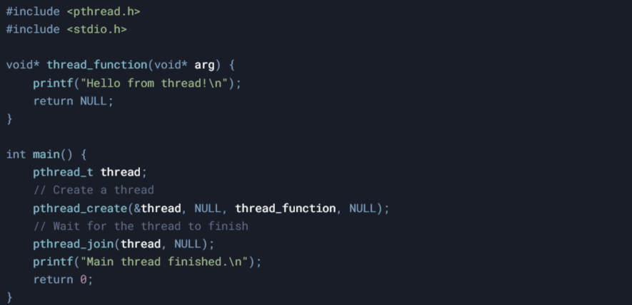
Comparison of Direct Execution and Thread API
Thread API: Provides tools for creating and managing threads. Suitable for multithreaded applications requiring parallel task execution. Adds overhead but ensures safety and manageability. Both approaches have their advantages and disadvantages, and the choice between them depends on the specific requirements of the task.

Slide 7
now we will look at everything step by step.
Let’s look at an example of creating and managing a thread using POSIX Threads (pthreads) in C:
Program Output
Hello from thread!
Main thread finished.
However, the order of execution may vary since threads run asynchronously.
This code illustrates the basic use of threads in C

Slide 8
1-step Including Header Files pthread.h — header file for working with POSIX threads. stdio.h — standard library for input/output (printf, etc.).
Let’s look at an example of creating and managing a thread using POSIX Threads (pthreads) in C:
2-step Thread Function
This is the function that runs inside the newly created thread.
It prints "Hello from thread!\n" and then terminates, returning NULL

Slide 9
3-step Main Function Declares a variable thread of type pthread_t, which will store the thread identifier.
Let’s look at an example of creating and managing a thread using POSIX Threads (pthreads) in C:
4-step Creating the Thread
pthread_create() creates a new thread:
&thread — pointer to the variable where the thread ID will be stored.
NULL — thread attributes (default).
thread_function — function that will execute in the thread.
NULL — argument for this function (not used).

Slide 10
5-step Waiting for the Thread to Finish pthread_join() suspends the execution of the main thread (main) until the created thread completes.
Let’s look at an example of creating and managing a thread using POSIX Threads (pthreads) in C:
6-step Printing in the Main Thread
After the thread completes, "Main thread finished." is printed, and the program exits.

Slide 11
Conclusion
In this presentation, we explored two key concepts: Direct Execution and Thread API.
Direct Execution provides high performance by allowing the CPU to execute code directly but requires careful handling of resources.
Thread API offers powerful tools for creating and managing threads, making it indispensable for multithreaded applications.
Understanding these mechanisms enables developers to create efficient, secure, and scalable software systems.

Slide 12

Thanks

